Slide 1

VEL TECH HIGH TECH
Dr. RANGARAJAN Dr. SAKUNTHALA ENGINEERING COLLEGE
An Autonomous Institution
Department of Information Technology
First Mini Project Review
IOT BASED MULTI-PATTERN FINGERPRINT SECURITY SYSTEM
Student 1 Name: Nithyanantham.R
Student 2 Name: Panbarasan.T.A
Student 3 Name: Arvindhan.G
II Year, Information Technology
Supervisor
Name :Ms.S.Mangalapriya
Designation : A.P/IT

Slide 2
IOT BASED MULTI-PATTERN FINGERPRINT SECURITY SYSTEM
Introduction:
Nowadays security becomes more advanced by biometric details, instead of giving unique inputs of biometric, we can give multi-pattern input forms a variety of complex sequence of individual person.
Earlier there was the type of registration method, username and password method, biometric security method which includes fingerprint, iris, face recognition.
On all the possibilities every methods have a drawback, but in this paper the enhacement of fingerprint is vast, which could facilitate the user with one security system but with multiple patternization.

Slide 3
IOT BASED MULTI-PATTERN FINGERPRINT SECURITY SYSTEM
Literature Review 1:
Title of the Research Paper | Key Points | Materials/ Software's used | Methodology/ Technique used | Inference
THE RESEARCH OF DOUBLE-BIOMETRIC IDENTIFICATION TECHNOLOGY BASED ON FINGER GEOMETRY AND PALM PRINT
(2011)
BIOMETRIC IDENTIFICATION
MULTI-BIOMETRIC IDENTIFICATION
FINGER GEOMETRY
PALM PRINT
FINGERPRINT AND PALM SCANNER ALONG IOT BASES
EXTRACTING FINGER CONTOUR OF FOREFINGER,MIDDLE FINGER,RING FINGER AND LITTLE FINGER, THE OTHER IS TO EXTRACT THE SQUARE REGION OF PALM PRINT.
THE PROCESS OF HAND GEOMETRY AND PALM PRINT CAN HAVE COMPLEMENTARY ADVANTAGES SO THAT THE PROCESS OF MATCHING WILL BE FAST AND HIGHLY ACTIVE.

Slide 4
IOT BASED MULTI-PATTERN FINGERPRINT SECURITY SYSTEM
Literature Review 2:
Title of the Research Paper | Key Points | Materials/ Software's used | Methodology/ Technique used | Inference
A NOVEL ALGORITHM FOR SECURE INTERNET BANKING WITH FINGER PRINT RECOGNITION
(2014)
SECURE INTERNET BANKING
FINGER PRINT RECOGNITION
BANKING TRANSACTION
FINGERPRINT SCANNER, EXAMINED AND BUILT DATABSE TO STORE FINGERPRINT TEMPLATES AND A SOFTWARE TO COMPUTE THE FINGERPRINTS MATCHES THE TEMPLATE OR NOT.
ON PROPOSED METHOD, THE USER HAS TO INPUT HIS/HER USER ID AND PASSCODE TO ENTER INTO THE BANKING SYSTEM. AND FOR FUTHER SECURITY PERSPECTION THE USER’S FINGERPRINT IS IN NEED TO COMPUTE THE TEMPLATE WITH THE FINGERPRINT. IF DOESN’T MATCHES THE ERROR IS TRANFERRED TO THE RESPECTIVE USER
THE USE OF THIS PROPOSED METHOD SECURITY OF ONE’S ACCOUNT IS ENHANCED SO THIS IS SAID TO BE A 100% SECURE METHOD.

Slide 5
IOT BASED MULTI-PATTERN FINGERPRINT SECURITY SYSTEM
Literature Review 3:
Title of the Research Paper | Key Points | Materials/ Software's used | Methodology/ Technique used | Inference
 |  |  |  | THIS METHOD REDUCES THE MISUSE OF VOTE AND ALSO REDUCES THE TIME TAKEN TO RECOLLECT ALL THE VOTE’S THAT HAS BEEN UPDATED ALL THROUGH THE VOTING PROCESS. APPLICATION OF THIS METHOD IMPLIES IN PROPORTION’S OF E-VOTING.
DESIGN AND IMPLEMENTATION OF CONVENIENT AND COMPULSORY VOTING SYSTEM USING FINGER PRINT SENSOR AND GSM TECHNOLOGIES
(2020)
FINGERPRINT SENSOR MODULE
GSM
ARDUINO
VOTING MACHINE
FINGERPRINT SENSOR, GSM MODULE,
ARDUINO MEGA2560 MICROCONTROLLER (IOT DEVICE) AND A VOTING MACHINE TO ENABLE THE ACCESIBILITY OF THE METHOD AND SKETCH ARDUINO 1.8.5 SOFTWARE.
ON THE PROPOSED DEVELOPMENT OF VOTING PROCESS THE VOTER HAS TO INPUT THERE FINGERPRINT BEFORE THE VOTING DAY, ON THE DAY OF VOTING THE VOTERS HAS TO VERIFY THEMSELVES WITH ANY OF THERE ID PROOF’S AND THERE FINGERPRINT IS BEEN VERIFIED IN THE VOTING MACHINE. THIS ENHANCES THE CAUSE OF VOTERS AND REDUCES THE MISUSE OF ONE’S INDIVIDUAL VOTE,WHERE FINALLY THE RESULTS ARE BEEN POSTED TO THE NEAR BY TALUK OFFICE IN TERMS OF ARDUINO AND GSM MODULE.

Slide 6
IOT BASED MULTI-PATTERN FINGERPRINT SECURITY SYSTEM
Literature Review 4:
Title of the Research Paper | Key Points | Materials/ Software's used | Methodology/ Technique used | Inference
BIOMETRIC AUTHENTICATION USING PALM DORSAL VEIN PATTERNS
(2020)
PALM-DORSAL VEIN PATTERN
REGIONS OF INTEREST
RADIUS DISTANCE METHODS
HIGH DEFINITION WEB CAM,LED INFRARED
ACQUIRING THE IMAGE OF PALM, CONVERTING IMAGE TO GRAY SCALE, CONVERTING REGION TO INTEREST, VEIN EXTRACTION, COMPARING OF PERSON IN THE DATABASE TO IDENTIFY THE USER.
THE PROPOSED TECHNIQUE WAS TESTED SUCCESFULLY FOR PERSON IDENTIFICATION.THE RESULT IS VERY PROMISING WITH 100% ACCURACY.

Slide 7
IOT BASED MULTI-PATTERN FINGERPRINT SECURITY SYSTEM
Literature Review 5:
Title of the Research Paper | Key Points | Materials/ Software's used | Methodology/ Technique used | Inference
FINGER VEIN RECOGNITION BASED ON DEEP CONVOLUTIONAL NEURAL NETWORKS
(2021)
FINGER VEIN RECOGNITION
ROI
CONVOLUTION NEURAL NETWORK
IMAGE FEATURE EXTRACTION
THE EXPERIMENTAL EQUIPEMENT IS AN INTEL CORE i7 PROCESSOR NVIDIA 1060 GRAPHICS CARD, 16GB OF MEMORY SYSTEM, OS FOR WINDOWS 10 SERVER. THE PROGRAMMING LANGUAGE USED WAS PYTHON 3.7 WITH BATCH SIZE SET 64 & A TOTAL OF 150 EPOCHS TRAINED.
REPEATED LINE TRACKING METHOD,WEIGHTED DIRECTED GRAPH.
THE EXPERIMENT WAS CARRIED OUT UNDER THE EXPERIMENT ENVIRONMENT AND PARAMETERS AND THE RESULTS WERE UNEXPECTED GOOD WITH 86% ACCURACY AND THE LOSS IS 0.9 APPROXIMATELY.

Slide 8
IOT BASED MULTI-PATTERN FINGERPRINT SECURITY SYSTEM
Block Diagram/Flowchart:
Fingerprint scanner
Arduino UNO R3 along with ESP-32 module
Web interface
Database
Matching score
Through ESP32
- Creation
- Verification
- Response

Slide 9
IOT BASED MULTI-PATTERN FINGERPRINT SECURITY SYSTEM
Objective:
To create new type of security system which is more secured based biometric detail in multiple pattern of input of it which gives unique number of pattern of ways to user, enabling secured access.
On the proposed pattern of our referred paper there are 126 ways of input patternization is given, as an advancement the input patternization can be upgraded upto 11,358,880 ways on the bases of combinatorics, from the proposed pattern consits of 4 inputs 1 empty value in the form includes 126 ways of input combination and over the bit theory of combinatoricsis .
This is to provide a advanced security system which could enhance the security of one person’s bank locker and also in military warehouses and more.

Slide 10
IOT BASED MULTI-PATTERN FINGERPRINT SECURITY SYSTEM
Methodology :
Step 1: All the required components as to be arranged as per the circuit diagram with a constant internet access.
Step 2: Firstly, the required code for processing the input has been uploaded to the arduino UNO microboard (IOT) along with the ESP-32 module.
Step 3: Then, after uploading the code, a set of multiple fingerprint patterns are bought from the user through fingerprint scanner and stored onto the web server as a template by the Esp-32 module or micro-modem.
Step 4: On the verification part, the user can be verified by inputing the same set of multiple patterns through fingerprint scanner which has been stored onto the web server.
Step 5: After receiving the inputs from the user, the code built within arduino micro controller checks and decides whether the given input is identical to the stored template from the web server.
Step 6: Based on the matching score from the inputs and the stored template, the result is displayed through the LCD panel.
Step 7: The purpose of deleting the existing template and inserting a new set of multiple patterns can be accessed from and modified through web interface.

Slide 11
IOT BASED MULTI-PATTERN FINGERPRINT SECURITY SYSTEM
Module description:
Module 1: Single fingerprint pattern implementation using Arduino UNO.
Step1: Arduino connection is implemented with fingerprint scanner as shown in the above circuit diagram.
Step2: Then, the required library Adafruit.fingerprint are downloaded on the IDE to proceed the process.
Step3: The c program code for single fingerprint pattern uploaded to arduino via type A cables
which is connected to system
Step4: Then, the single fingerprint are got from the user and stored in database
Step5: On verification, test data(fingerprint) and original data stored in database are compared and the result is displayed on serial monitor.

Slide 12
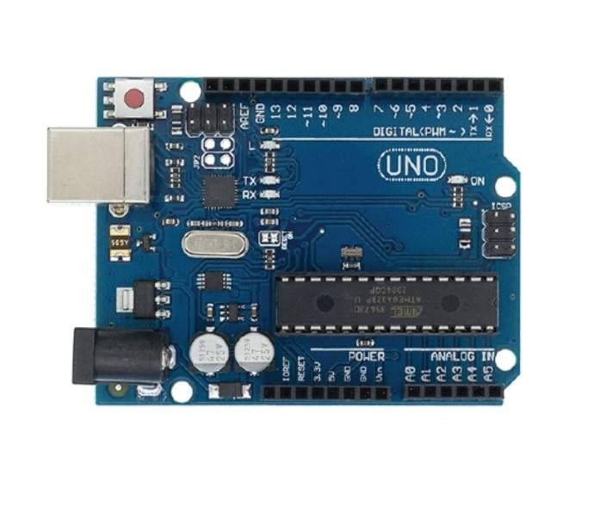
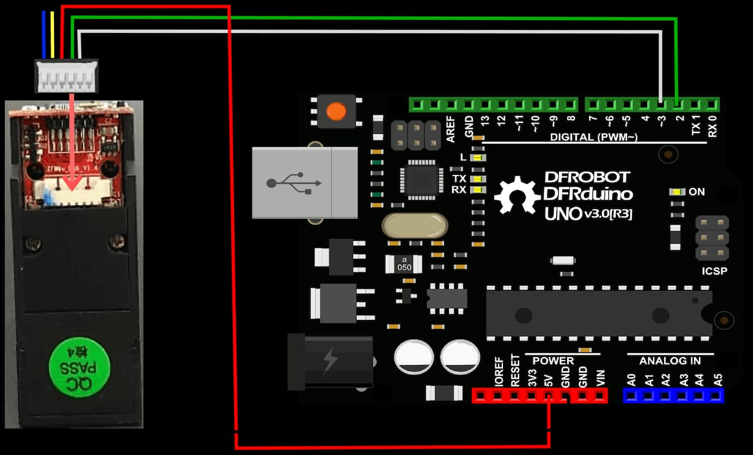
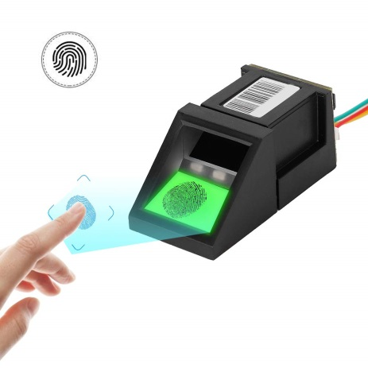
IMAGES RELATED TO MODULE 1:

Slide 13
IOT BASED MULTI-PATTERN FINGERPRINT SECURITY SYSTEM
Requirements (Materials/Components, Hardware/Software):
Arduino Uno rev.3
ESP-32 module
Fingerprint sensor
Arduino IDE in c language
LCD display
Connecting two pin sockets
DC 12v 2apm power supply adaptor

Slide 14
IOT BASED MULTI-PATTERN FINGERPRINT SECURITY SYSTEM
Project Cost / Budget:
S.No | Activity | Amount Rs
1 | Arduino Uno r3 | 750
2 | Esp32 wifi moderm(module) | 575
3 | Fingerprint scanner | 1325
4 | LCD display | 225
5 | DC 12V 2A power supply adaptor | 250
 | Total Budget | 3125

Slide 15
IOT BASED MULTI-PATTERN FINGERPRINT SECURITY SYSTEM
Milestone Activity:
Period | Scheduled Activity
Week 1
Week 2
Week 3
Week 4
Week 5
Week 6

Slide 16
IOT BASED MULTI-PATTERN FINGERPRINT SECURITY SYSTEM
Milestone Activity:
Period | Scheduled Activity
Week 7
Week 8
Week 9
Week 10
Week 11
Week 12

Slide 17
IOT BASED MULTI-PATTERN FINGERPRINT SECURITY SYSTEM
References:
CHLAOUA, Rachid, MERAOUMIA, Abdallah, AIADI, Kamal Eddine,et al. Deep learning for finger-knuckle-print identification system basedon PCANet and SVM classifier. Evolving Systems, 2019, vol. 10, no 2,p. 261-272.
KRIZHEVSKY, Alex, SUTSKEVER, Ilya, et HINTON, Geoffrey E. ImageNet classification with deep convolutional neural networks. In: Advances in neural information processing systems. 2012. p. 1097-1105.
SIMONYAN, Karen et ZISSERMAN, Andrew. Very deep convolutional networks for large-scale image recognition. arXiv preprintarXiv:1409.1556, 2014.
Acharya, U. R., Fujita, H., Oh, S. L., Hagiwara, Y., Tan, J. H., & Adam,M., ”Application of deep convolutional neural network for automated detection of myocardial infarction using ECG signals”, Information Sciences, 415, 190-198, 2017.
WANG, Kai, ZHAO, Youjin, XIONG, Qingyu, et al. Research on healthy anomaly detection model based on deep learning from multiple timeseries physiological signals. Scientific Programming, 2016, vol. 2016.

Slide 18
Thank you

